Slide 1
Unity DOTS
Data Oriented Tech Stack
“Performance by default”

Slide 2

Projects using DOTS: Diplomacy Is Not An Option

Slide 3

Projects using DOTS: Hardspace: Shipbreaker

Slide 4

Projects using DOTS

Slide 5

DOTS Performance Comparison

Slide 6
Data-Oriented Design
From Wikipedia: data-oriented design is a program optimization approach motivated by efficient usage of the CPU cache, used in video game development. The approach is to focus on the data layout, separating and sorting fields according to when they are needed, and to think about transformations of data.

Slide 7
Data-Oriented Design
Data oriented design

Slide 8
Data-Oriented vs Object-Oriented Design.

Slide 9
Pure C# Example
Let’s say I want to store a collection of squares. Each square has:
Position (int x, int y)
Size (int width, int height)
Color (int r, int g, int b)
And I want to be able to move these squares by changing their position.

Slide 10
Pure C# Example
Object-Oriented Design:
We’ll create an object that represents a square with all of its values and methods, and then create a collection of squares:
Data-Oriented Design:
We’ll create a collection for every value of a square, and implement the methods in the collection itself:
private class Square { private int x; private int y; private int width; private int height;
private (int, int, int) color;
public void MoveBy(int deltaX, int deltaY) { x += deltaX; y += deltaY; } }
public class SquareCollection { private readonly int[] allXs; private readonly int[] allYs;
private readonly int[] allWidths; private readonly int[] allHeights; private readonly (int, int, int)[] allColors; public void MoveBy(int deltaX, int deltaY) { for (int i = 0; i < allXs.Length; i++) { allXs[i] += deltaX; allYs[i] += deltaY; } } }
public class SquareCollection { private readonly Square[] collection; public void MoveBy(int deltaX, int deltaY) { for (var i = 0; i < collection.Length; i++) { collection[i].MoveBy(deltaX, deltaY); } } }

Slide 11
Pure C# Example
To test the performance, I’ve created an object of each type with varying sizes, and called MoveBy for each.
Timing results:
10 squares. Elapsed ticks: object oriented: 1,339 > 1,260: data oriented
100 squares. Elapsed ticks: object oriented: 3 < 40: data oriented
1,000 squares. Elapsed ticks: object oriented: 16 < 45: data oriented
100,000 squares. Elapsed ticks: object oriented: 2,657 > 1,878: data oriented
1,000,000 squares. Elapsed ticks: object oriented: 27,807 > 16,817: data oriented
10,000,000 squares. Elapsed ticks: object oriented: 1,553,522 > 169,251: data oriented
As you can see, with a small number of squares, object-oriented is faster. But once you have a lot of squares, data-oriented is a lot faster.

Slide 12
Why?
When we used object-oriented design, the class had other variables that we didn’t use, that were loaded into the CPU’s cache.
But when we used data-oriented design, we only loaded the variables we needed, which let us use more of the CPU’s cache efficiently.

Slide 13
Data-Oriented Design in Unity
Unity has recently implemented a system for using data-oriented design in games.
This system is called DOTS: Data Oriented Tech Stack.

Slide 14
DOTS
DOTS is actually three things:
Entity Component System (ECS)
C# Job System
Burst Compiler
The ECS and the job system can be used separately, but they are much more powerful together.

Slide 15
Entity Component System (ECS)
The Entity Component System is also three things:
Entities
Components
Systems

Slide 16
Entities - Things
An entity is the equivalent of an object in object-oriented design.
But here, it does not actually exist. It’s only a concept – like the square in the C# example.
The entities are separated into types (called Archetype) based on the Components they have (and some of these components’ data).
Entities of the same type are stored together in the memory (called chunks), which speeds up reading and writing.

Slide 17
Components - Data
A component is a struct that stores data about an entity. Every component stores only highly related data. Non-related data should be stored on a separate component.
In the C# example, we would have had one component for the position, one for the size, and one for the color.

Slide 18
Systems - Actions
A system is a function that performs an action on a type of entity.
In the C# example, the MoveBy function would be a system.

Slide 19
The C# Job System
The Job System is basically a multithreading solution.

Slide 20
The Burst Compiler
Speeds up the C# Job System by translating IL/.NET to highly optimized native code.

Slide 21
DOTS In Practice
So, how do we do it?
For DOTS we need the following packages:
Entities – The Entity Component System
Hybrid Renderer – For rendering meshes using ECS
Jobs – The C# Job System
Burst – The Burst Compiler
So let’s create a new Unity 3D project and get started!

Slide 22
Installing the Packages
Open the Package Manager window (Window -> Package Manager)
Enable Preview Packages.
Unity 2019: Package Manager -> Advanced -> Show Preview Packages.
Unity 2020: Edit -> Project Settings -> Package Manager -> Advanced Settings -> Enable Preview Packages.
In the Package Manager, search for and install the following package:
Hybrid Renderer
Unity should automatically install all of its dependencies, which include the other packages we need.

Slide 23
Setting Up the Project
For organization, create a ‘Scripts’ folder in the Assets, And create ‘Components’, ‘Systems’, and ‘MonoBehaviours’ subfolders.
Why do we need MonoBehaviour? – They will mostly be used to instantiate the entities.

Slide 24
Let’s create an Entity!
Create a new script. Let’s call it Spawner.
Add the following using statements on top:
using Unity.Entities; // For ECS
using Unity.Mathematics; // For math in ECS
using Unity.Transforms; // For the equivalent of Transform in ECS
They are required when working with the Entity Component System.

Slide 25
Let’s create an Entity!
Create a function, let’s call it SpawnEnitity, and add the following line:
EntityManager entityManager = World.DefaultGameObjectInjectionWorld.EntityManager;
So, what do we have here? In ECS, every Entity must be part of a World, similar to Scenes in the classic Unity. Every World has exactly one EntityManager which is in charge of managing Entities: creating them, destroying them, and adding or removing Components from them.
World.DefaultGameObjectInjectionWorld will return the current World, from which we retrieve it’s EntityManager.

Slide 26
Let’s create an Entity!
To create an Entity, we must tell Unity what it’s Archetype is. Add the following code to your function:
EntityArchetype archetype = entityManager.CreateArchetype( typeof(Translation), typeof(Rotation) );
This will create a new Archetype (named archetype) with the following components:
Translation – which tells Unity where the Entity is, and
Rotation – which tells Unity the Entity’s orientation.
Notice that what is only one component in the classic Unity – Transform – is actually three different Components in ECS: Translation, Rotation, and Scale.

Slide 27
Let’s create an Entity!
Now we can create the actual Entity:
Entity myEntity = entityManager.CreateEntity(archetype); var translation = new Translation(); translation.Value = new float3(2f, 0f, 4f); entityManager.AddComponentData(myEntity, translation);
What did we do? We created a new Entity of the Archetype we created earlier, and then added data to it’s Translation Component. The Translation Component has a single field, Value, which is of type float3, an equivalent of Vector3 for ECS. In Components that have only one field, that field is usually called Value.

Slide 28
Let’s create an Entity!
Add a call to the function in Start, and let’s switch back to Unity.
Create a new GameObject and add the script to it.
Hit play… and nothing happened!
Actually, that’s not true. As Entities aren’t GameObjects, you won’t see them in the Hierarchy. And as our Entity doesn’t have a renderer, we can’t see it in the Scene or Game. To view Entities, we have to open the Entity Debugger. Go to Window -> Analysis -> Entity Debugger. You should keep this window somewhere handy. I usually place it together with the Console.

Slide 29
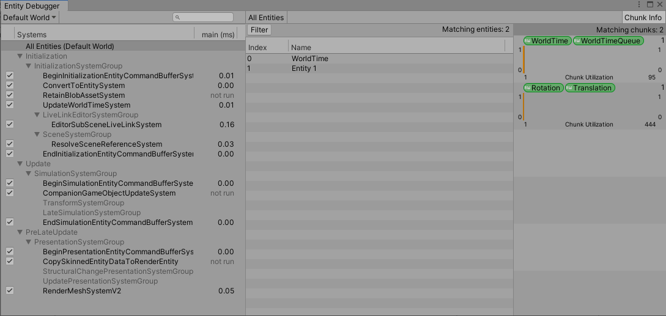
The Entity Debugger window
When you’ll open the Entity Debugger, you’ll see the following:

Slide 30
The Entity Debugger window
To the left, we have the Systems List. Here, you will see all the active systems, and how much time a system takes to run each frame.
Make sure the “All Entities (Default World)” is selected.
In the middle column, we have all the entities in our game. You’ll notice there are two Entities: one called “WorldTime”, which holds the time information about our game, and another called “Entity 1”, which is the Entity we created.
On the right, we have the Chunk Information, which contains information about the chunks in our game.

Slide 31
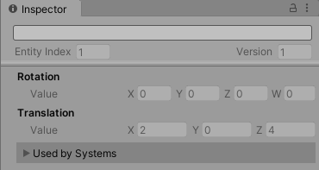
The Entity Debugger window
Click on our Entity, and take a look at the Inspector.
You should see the following:
The Inspector shows the Components of each Entity and their content. Notice that you can’t edit anything (other than the name).

Slide 32
Adding a mesh to an Entity
So, we have an Entity. But what goo does it do if it doesn’t affect the game in any way? Let’s add to it a mesh renderer.
Open the script from earlier, and add the following using statement:
using Unity.Rendering; // For rendering in ECS
It contains all the necessary things for rendering in ECS.

Slide 33
Adding a mesh to an Entity
In the class, create the following parameters:
public Material mat; public Mesh mesh;
We will need them to tell unity what mesh to render, and using what material.

Slide 34
Adding a mesh to an Entity
In the SpawnEnitity function, when we create the Archetype, add the following Components: typeof(RenderMesh) typeof(RenderBounds) typeof(LocalToWorld)
RenderMesh is the equivalent of the MeshRenderer component in classical Unity, and RenderBounds is the equivalent of the MeshFilter. LocalToWorld is used it translate local coordinates to world coordinates, and is required by the others.

Slide 35
Adding a mesh to an Entity
Lastly, we need to add the data for the Components. Add the following at the end of the function:
var renderMesh = new RenderMesh(); renderMesh.mesh = mesh; renderMesh.material = mat; entityManager.AddSharedComponentData(myEntity, renderMesh);
Which will tell the Unity what Mesh we want to render, and with what material.
Note that we used AddSharedComponentData. This is used when values aren’t changed regularly, so that unity can optimize the memory layout of the Entities.

Slide 36
Adding a mesh to an Entity
Save the script and go back to Unity.
Set the script’s values in the Inspector. You can set the “mat” to Default-Material, and the “mesh” to Cube.
Hit play. You’ll see a cube in the Game view.
While still in play, go to the Scene view. You’ll notice that you can’t select the cube, as it is not a GameObject.
If you select the cube in the Entity Debugger, you’ll see that there are some new Components that were added to our Entity. The Hybrid Renderer Pipeline added them, as they are needed to render meshes.

Slide 37
Entity Conversion Workflow
We’ve learned how to create an Entity using code. But this is complicated, and hard to implement for an entire project.
So, Unity created a simpler way to create Entities: the Entity Conversion Workflow.
We create a GameObject, and Unity will convert it to an Entity when we hit play.
So let’s get started!

Slide 38
Entity Conversion Workflow
Create a Cube in the Scene. Let’s call it “ConvertedEntity”.
Add the ConvertToEntity component.
Now, when you hit play, you’ll see two cubes: the old cube we created with the script, and the new one. You’ll notice that the new cube does not show up in Hierarchy. Of course – it’s an Entity. It will only show up in the Entity Debugger window.

Slide 39
Creating Components
So we have an Entity. But what do we do with it?
Let’s create a Component that will store data for movement.
Create a new script – let’s call it “MoveDataComponent”. Delete it’s content and paste the following:
using Unity.Entities; using Unity.Mathematics; public struct MoveData : IComponentData { public float3 direction; public float speed; }

Slide 40
Creating Components
There are some things that you should note:
Components must be structs.
A Component’s name does not have to match the file name.
A Component must only contain blittable types.
Blittable types are types that have a fixed memory size. Most of the built-in types are blittable: int, float, double, char, bool. Note that references to arrays are not blittable. For more information, visit the .NET documentation.
The Unity.Mathematics namespace contains blittable types for ECS, including a blittable version of Quaternion and Vector3, quaternion and float3.

Slide 41
Creating Components
So we’ve created a Component. Adding it to an entity created from code is simple – just add it to the Archetype, and then add some data to it.
But how do we add it to an Entity that is created using the Entity Conversion Workflow?
We need to add the [GenerateAuthoringComponent] to our Component. This will let us add our Component to a GameObject with the ConvertToEntity component, as if it’s a regular Monobehaviour script.
Add it to “ConvertedEntity” and give it some values (e.g. (1, 0, 0) and 1).

Slide 42
Creating Components
You can delete the “Spawner” GameObject for now.
Click play.
When you select our Entity in the Entity Debugger, you should see the MoveData Component in the Inspector.

Slide 43
Creating Systems
So we’ve created a Component. Let’s create a System that will use it.
Create a new script, let’s all it “MoveSystem”. Delete everything and paste the following:
using Unity.Entities; using Unity.Mathematics; public class MoveSystem : SystemBase { protected override void OnUpdate() { } }
This is the System template.
Also here, the System name does not have to match the file name.

Slide 44
Creating Systems
Add the following code inside the OnUpdate() function (note that you need to add the using Unity.Transforms; Statement):
var deltaTime = Time.DeltaTime; Entities.ForEach((ref Translation translation, in MoveData moveData) => { float3 normalizedDirection = math.normalize(moveData.direction); translation.Value += normalizedDirection * moveData.speed * deltaTime; }).Run();

Slide 45
Creating Systems
Let’s go over it slowly.
First, we save the delta time in a variable.
Then, we call Entities.ForEach and pass in a lambda, that:
Declares a ref Translation variable.
Declares a in MoveData variable.
Moves the translation according to the MoveData and delta time.
Finally, we call .Run() on the object Entities.ForEach returns.

Slide 46
Creating Systems
What does that mean?
Entities.ForEach will run our lambda on all the Entities, that have all of the variables declared, where:
ref signifies we want to write to the Entity, and
in signifies that we only want to read from the Entity.
All in variables must appear after all ref variables.
For more advanced queries, visit the Entities.ForEach documentation.

Slide 47
Creating Systems
Save the script, go back to Unity and click play.
You should see the cube move to the direction and at the speed you specified.

Slide 48
The C# Job System and the Burst Compiler

Slide 49
Using the C# Job System with ECS
To use the C# Job System with ECS, we simply change the call of the ForEach query in a ECS System to:
.Schedule() if we want to run it on the same worker thread, or
.ScheduleParallel() if we want to run it on separate threads in parallel.
Note that if you run a system as a Job, it cannot access the main Unity functions like Input.GetButton and Time.DeltaTime.

Slide 50
Useful links
https://nikolayk.medium.com/getting-started-with-unity-dots-part-1-ecs-7f963777db8e - a more in-depth explanation of Unity DOTS.
https://www.youtube.com/playlist?list=PL-05SQhI5rIYuRbANfxjt7G2C9oFch0al – an introduction to Unity DOTS. Most of this tutorial is based on this playlist.
https://www.youtube.com/playlist?list=PL-05SQhI5rIY2MVt5s_EfvddNXS2GNAtA - using DOTS to create a game.
https://docs.unity3d.com/Packages/com.unity.entities@latest/ - the Entities package documentation.
https://docs.unity3d.com/Manual/JobSystem.html - the C# Job System documentation.

